Slide 1
Applying Global Illumination on height field based terrain using OpenGL
Jonathan M Chye
Technical Supervisor : Mr Matthew Bett
2010

Slide 2
ABSTRACT
Apply GI techniques to outdoor terrain
Cheap and efficient
OpenGL and C++
Terrain represented by height maps
Spherical Harmonics lighting + ray tracing
Features:
Dynamically generated terrain read from height maps
Shadowing – soft shadows, self-shadowing, dynamically shadowed
Fully lit – indirect lighting
Textured
Good frame rates

Slide 3
INTRODUCTION
Global Illumination – What is it?
Algorithms used to enhance realism using lighting for a 3D scene
Also takes into account light reflected by objects from light source – indirect illumination
Common algorithms – Ray tracing, ambient occlusion, photon mapping
Why GI?
Photorealism
Important in many applications – flight simulators, geographical data analysis
CGI – entertainment industry

Slide 4
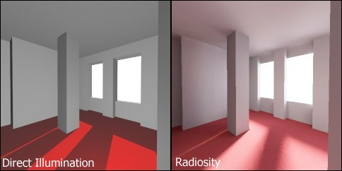
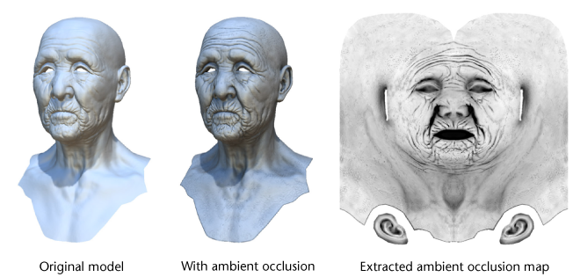
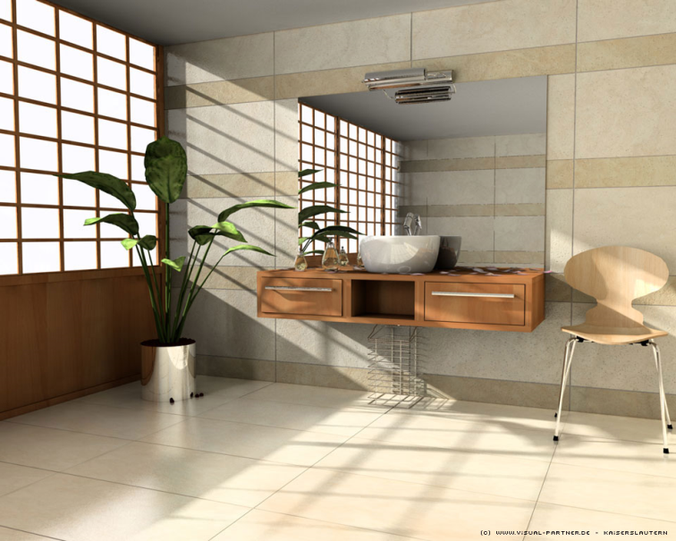
GI Examples

Slide 5
Literature Review
Rendering equation :
equilibrium radiance leaving a point is given as the sum of emitted plus reflected radiance under a geometric optics approximation (Wikipedia)
GI algorithms tries to solve this equation
Ray tracing, photon mapping, radiosity and ambient occlusion.

Slide 6
Methodolodgy
Aim :
real-time demo application featuring a heightmap-based terrain lit using an efficient Global Illumination algorithm
realistic environmental, area lights found in outdoor landscapes, soft shadows and indirect lighting
algorithm should allow to scale the complexity of calculations on demand

Slide 7
Methodology
Project Planning
Gantt Chart
Two main phases – Algorithm & Implementation
Vanilla Framework
Testing and implementation

Slide 8
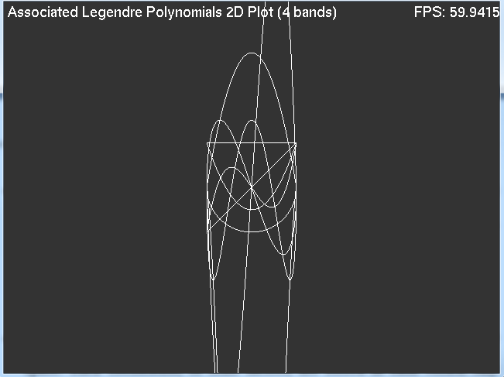
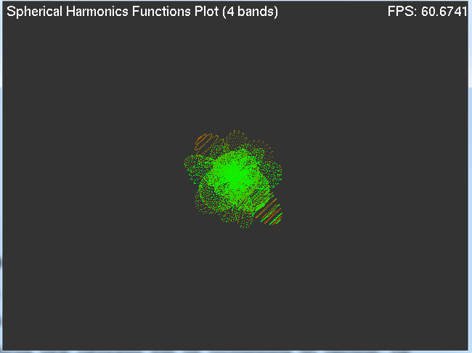
Methodology
Appmodes :
ALP
SH basis function

Slide 9
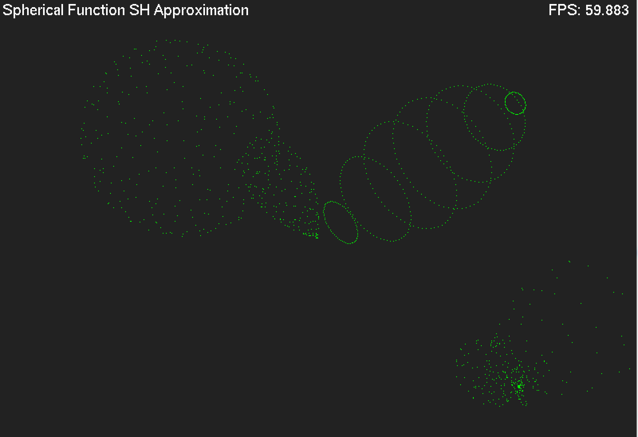
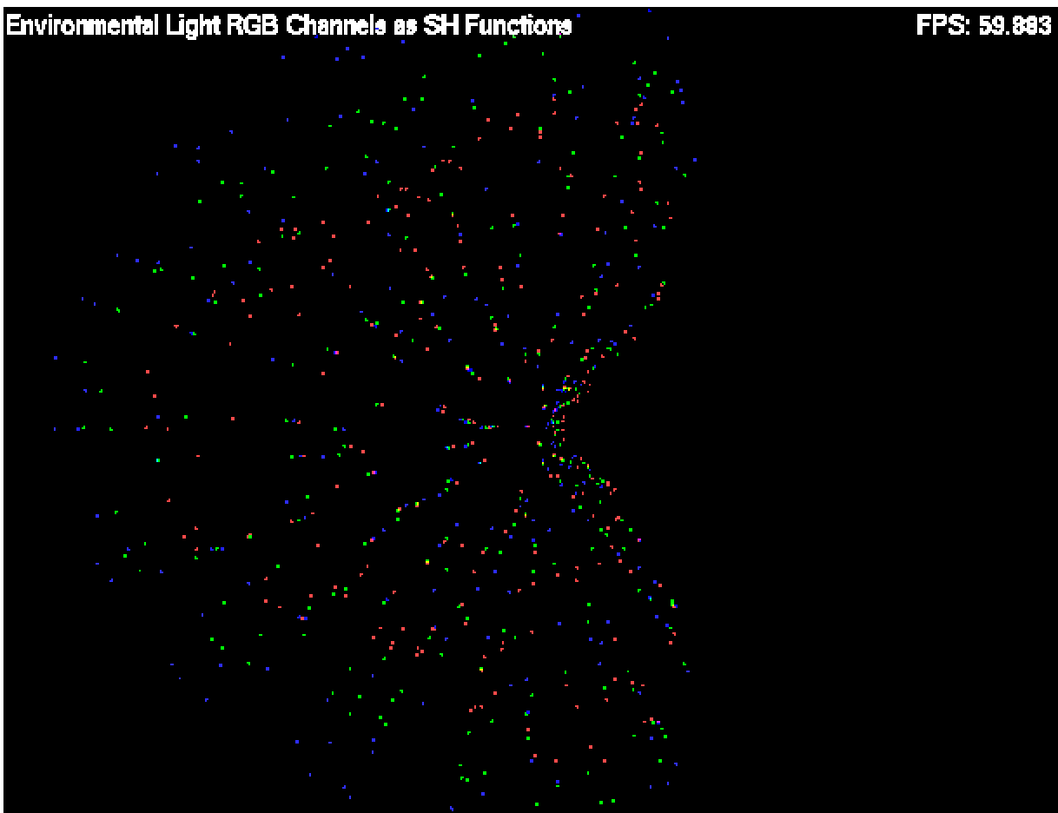
Methodology
SH samples in 3D space + simple mathematically-defined spherical function and its coarser SH approximation
Environmental light function coming from a HDR light sphere - projected into SH space

Slide 10
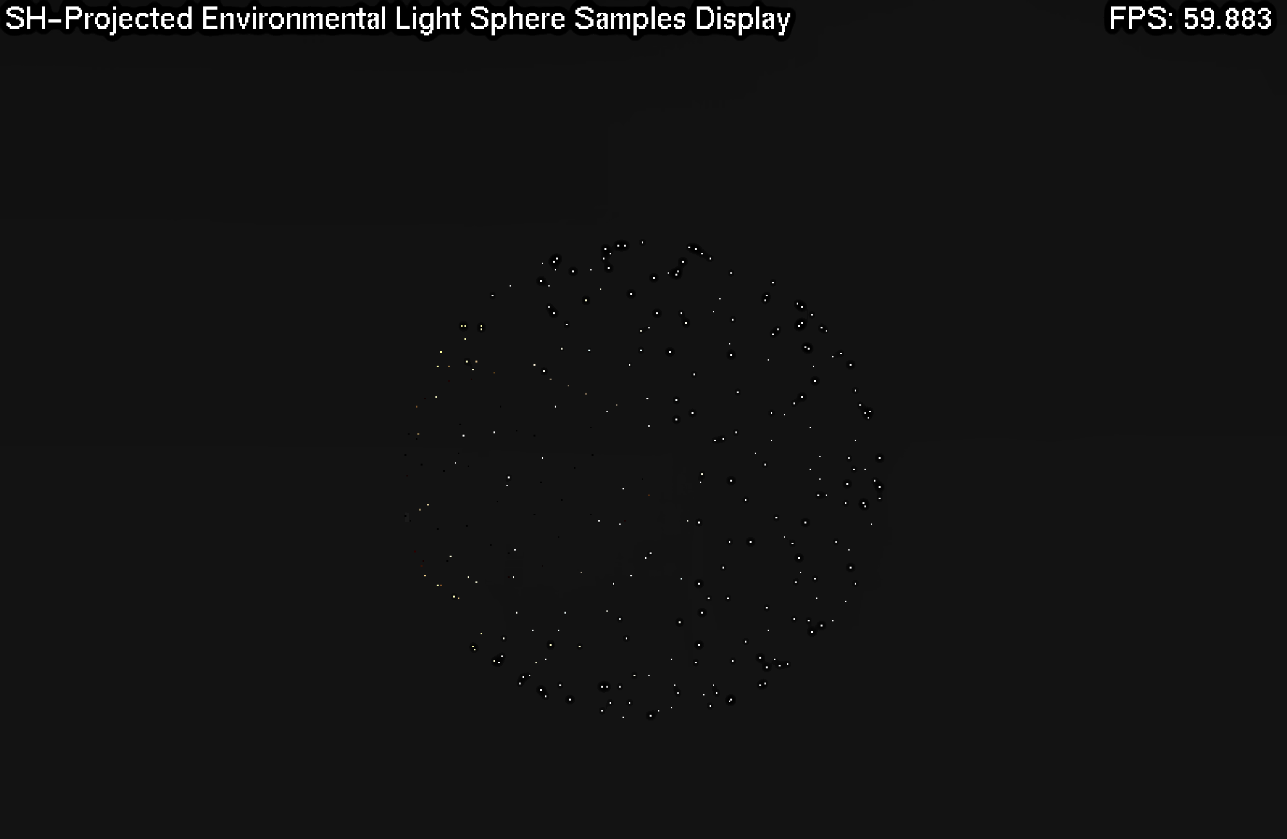
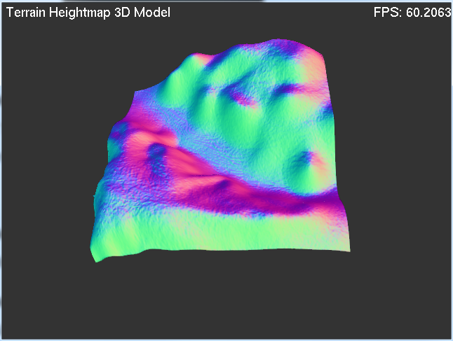
Methodology
Environmental light function on a unit sphere, with the RGB channels combined and scaled
Simple 3D terrain model

Slide 11
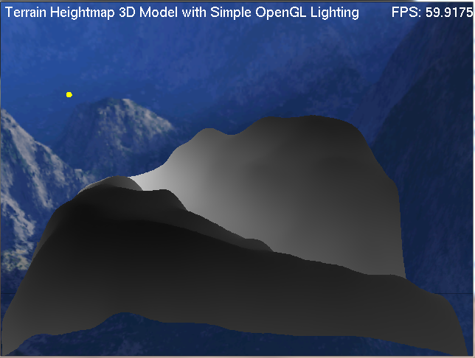
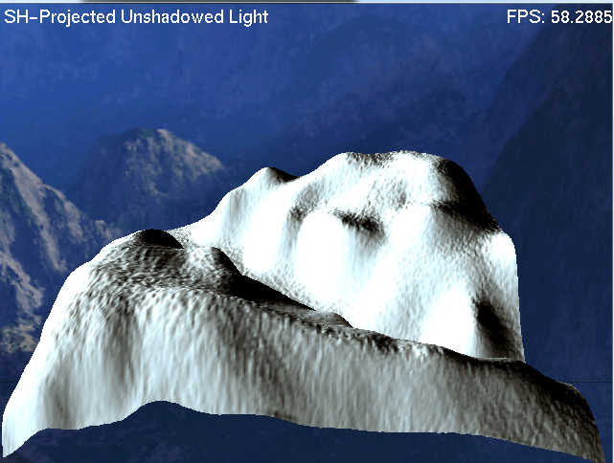
Methodology
Terrain lit by simple OpenGL lighting
Terrain mesh lit using the Un-shadowed SH Global Illumination method

Slide 12
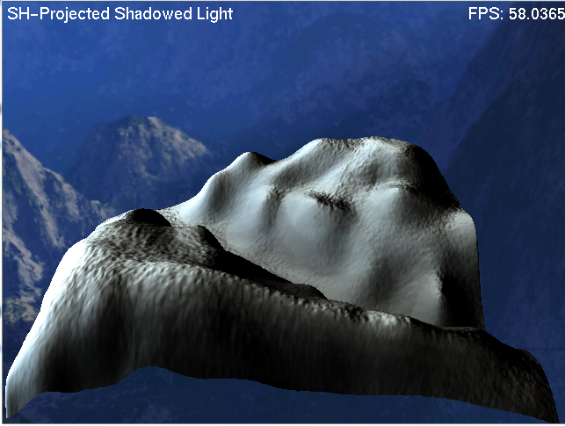
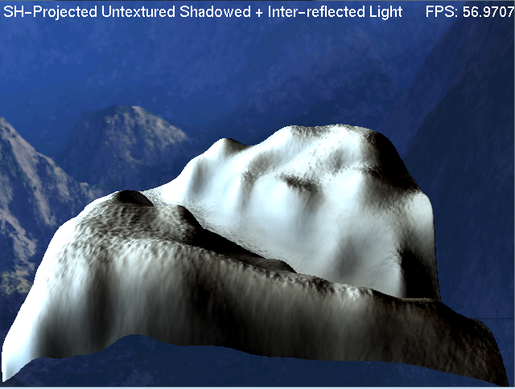
Methodology
Mesh lit using the Shadowed SH GI method
Mesh lit using the Inter-reflected Shadowed SH GI method

Slide 13
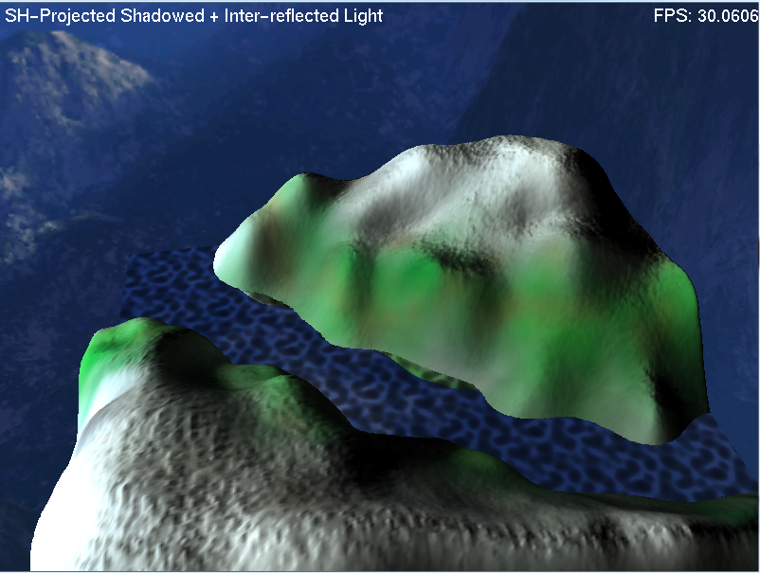
Methodology
Final fully textured and lit using full GI

Slide 14
Methodology
Data Organisation
Structure to store SH coefficient calculations and encoded spherical function (environment light) at given point of the sphere values.
Vertex structure - holds Cartesian coordinates, normal vector, diffuse colour, texture coordinates and 3 arrays of SH coefficients.
Basic un-shadowed lighting
Projection function - calculates SH coefficients using spherical samples array. Encodes both vertex colour and normal using SH
Shadowed lighting
Custom Ray Tracer algorithm used to calculate self-shadowing of vertices. Algorithm shoots a “ray” along the axis calculated from the spherical sample direction vector, using current vertex position as origin. This prevents occluded light directions being taken into account in encoding vertex SH coefficients
Calculate final (real) vertex colour every frame by combining its own SH coefficients and real-time rotated light ones
Indirect Lighting
Find neighbouring vertices and indirect light emitted using same ray tracer algorithm as shadowed lighting. Results stored in separate buffer.
Results then added to previous Shadowed lighting values

Slide 15
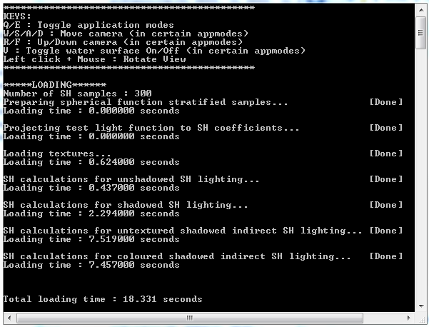
Results
Evaluation protocol ?
Performance - FPS counter
Visual Judgement
Console window – debug information

Slide 16
Results - Analysis
First attempts – shaders
GLSL & Cg – Failed attempt
Fully CPU dependant code
Results as predicted – model lit correctly
Soft shadows – working
Indirect lighting – added realism

Slide 17
Results

Slide 18
Conclusion
Summary :
Project successful – implemented & observed GI
Very time consuming – literature
Technical issues
Trial & Error
Successful, lightweight and compact implementation of a real-time Global Illumination algorithm with significantly low hardware requirements

Slide 19
Future Work
Further optimise algorithm
Storage of hit vertices during the indirect light preprocessing step
Usage of single-precision floats instead of double-precision ones
Shifting some of the real-time calculations to the GPU
The ray tracer could use the concept of multi-level height and colour pyramids used in (Nowrouzezahrai and Snyder, 2009)
Addition of dynamic objects
Making solution fully real time

Slide 20
Questions?

